Slide 1


Slide 2



Slide 3

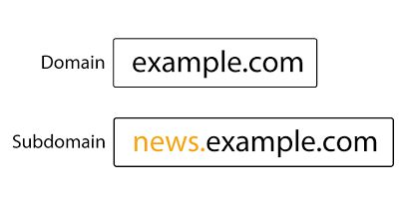
What is Subdomain Enumeration?
The process of finding sub-domains for one or more domain(s)

Slide 4

Why is Subdomain Enumeration?
It reveals a lot of domains/sub-domains that are in scope of a security assessment which in turn increases the chances of finding vulnerabilities
Finding applications running on hidden, forgotten sub-domains may lead to uncovering critical vulnerabilities
The famous Yahoo! Voices hack happened due to a vulnerable application deployed on a yahoo.com sub-domain

Slide 5
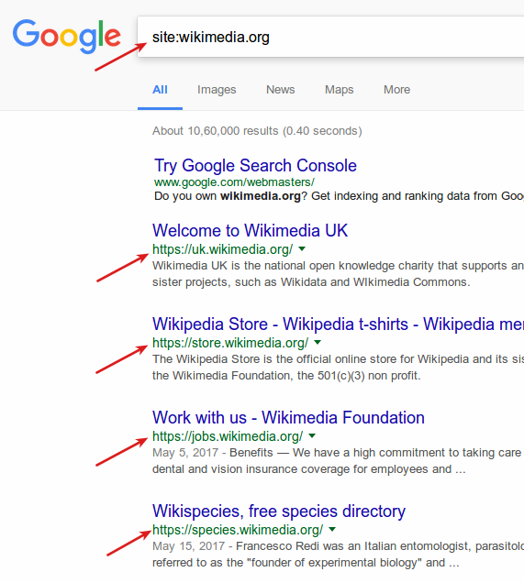
Subdomain Enumeration Techniques
1. Search engines like Google and Bing supports various advanced search operators to refine search queries. These operators are often referred to as “Google dorks”.
We can use “site:” operator in Google search to find all the sub-domains that Google has found for a domain.

Slide 6
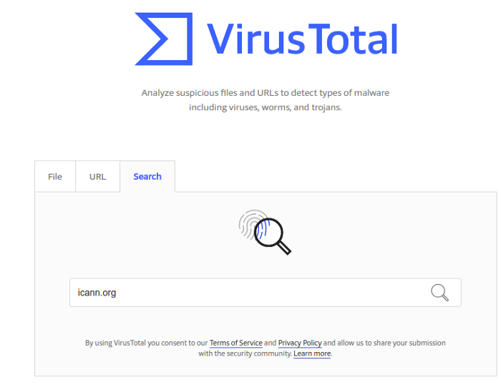
There are a lot of the third party services that aggregate massive DNS datasets and look through them to retrieve sub-domains for a given domain.
2) Virus Total
https://www.virustotal.com/gui/

Slide 7
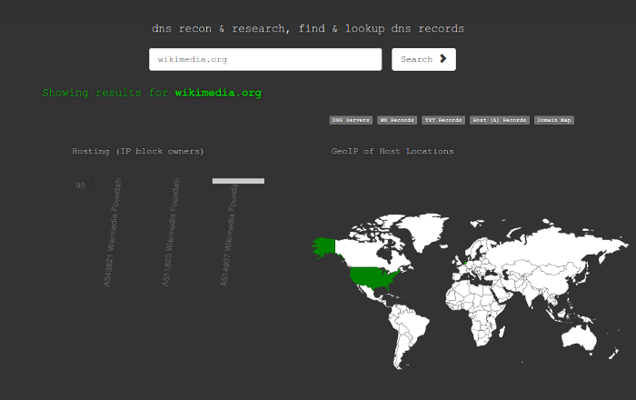
3) DNSdumpster
https://dnsdumpster.com/

Slide 8
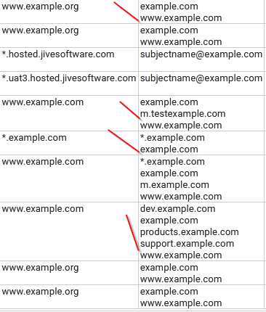
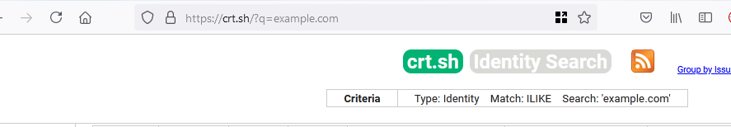
3)CRT.SH
https://crt.sh/

Slide 9
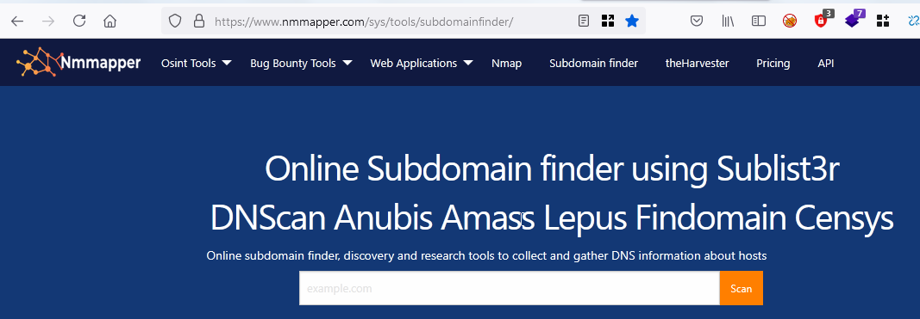
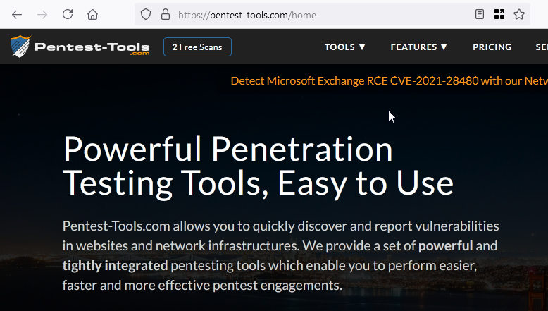
4) Nmmapper
https://www.nmmapper.com/sys/tools/subdomainfinder/
5) Pentest-tools
https://pentest-tools.com/home

Slide 10
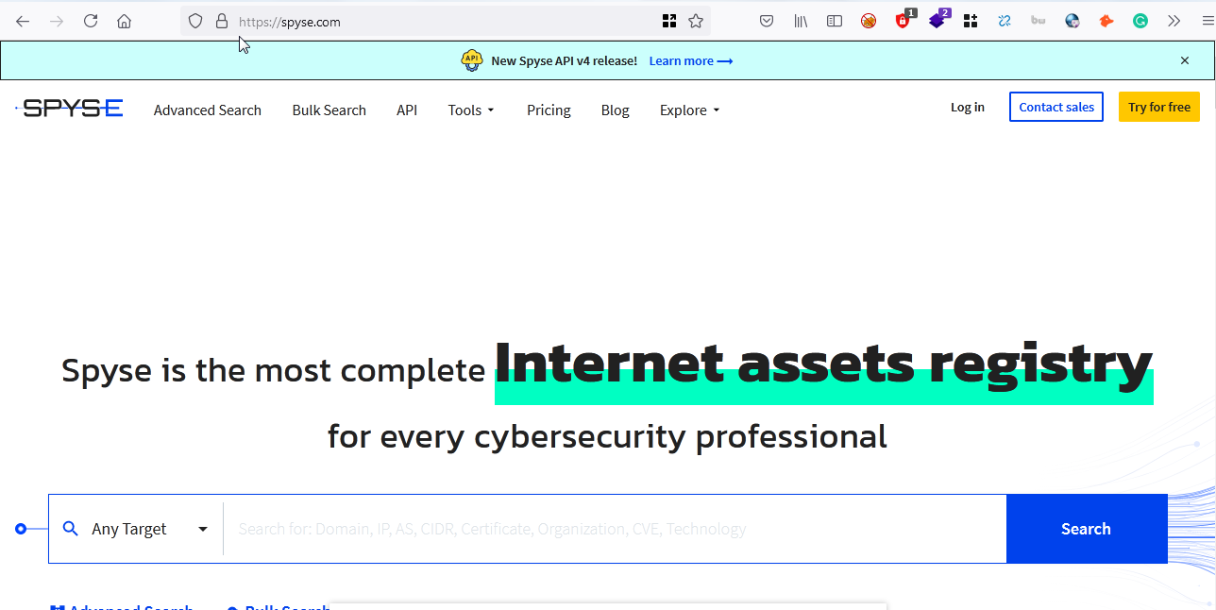
6) Spyse
https://spyse.com/
https://www.youtube.com/watch?v=1QpDcuTloNU&t=119s

Slide 11
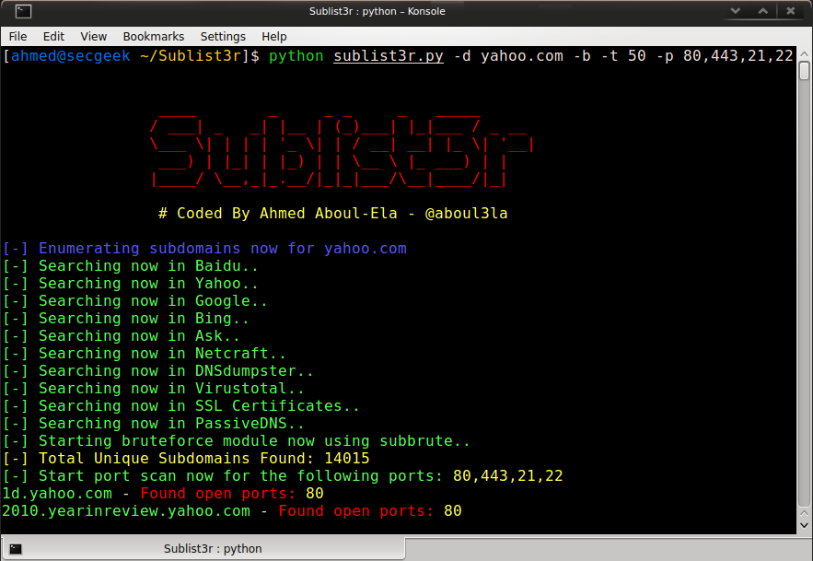
CLI TOOLS
1) Sublist3r:
Sublist3r enumerates subdomains using many search engines such as Google, Yahoo, Bing, Baidu and Ask.
sudo apt install sublist3r
sublist3r -d target.com

Slide 12
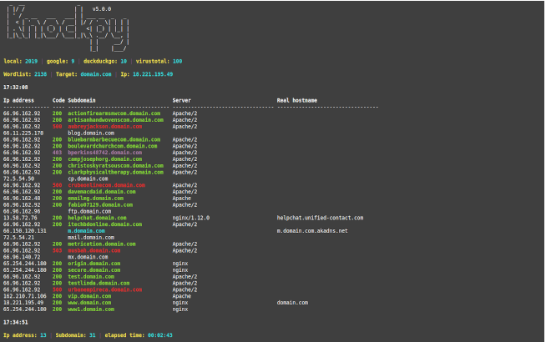
2)Knockpy
is a python3 tool designed to enumerate subdomains on a target domain through dictionary attack.
Steps to install:
git clone https://github.com/guelfoweb/knock.git
python3 setup.py install
knockpy domain.com

Slide 13

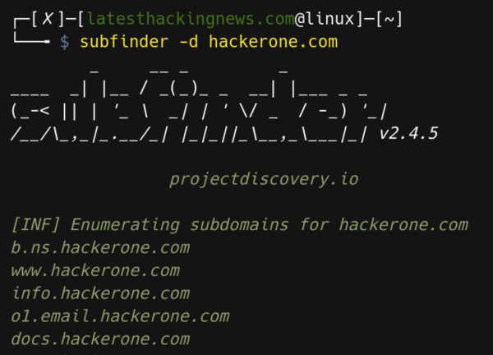
Subfinder
is a subdomain discovery tool that discovers valid subdomains for websites by using passive online sources.
https://github.com/projectdiscovery/subfinder

Slide 14

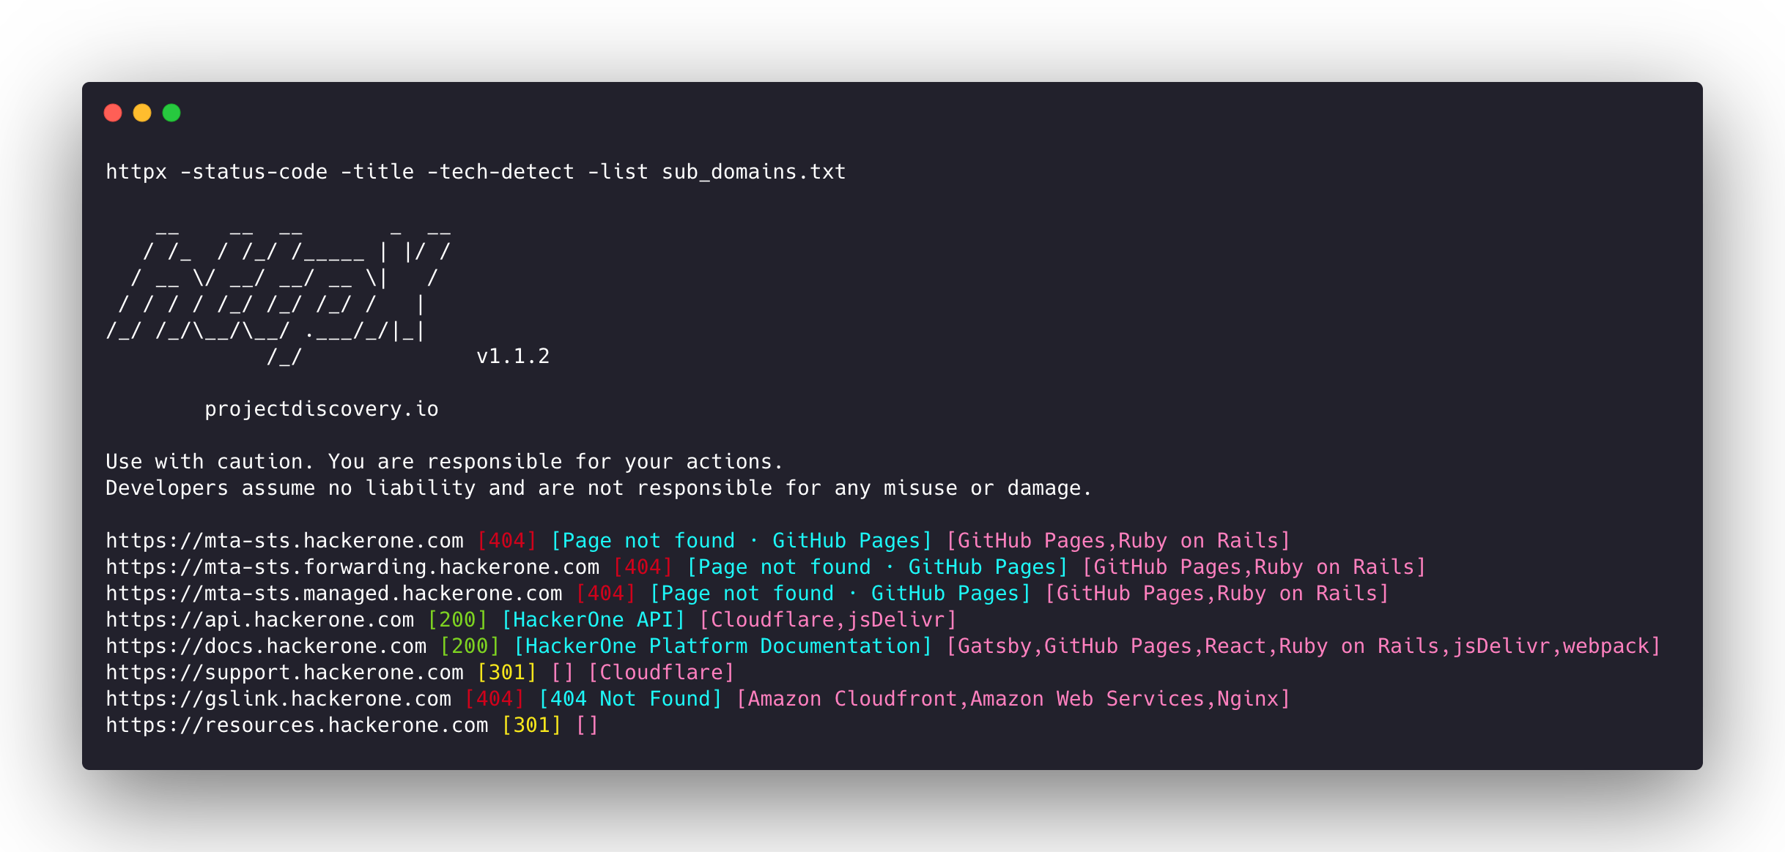
httpx
is a fast and multi-purpose HTTP toolkit allow to run multiple probers using retryablehttp library.
https://github.com/projectdiscovery/httpx

Slide 15
How to use both tools together:
subfinder -d target.com | httpx > target.txt
cat target.txt | waybackurls | tee wayback.txt

Slide 16
THANK
YOU

